Slide 1

Design and Implementation Of Data Security In IoT
20%
Presented By:
DEBDUT DAS, MEHELI RAY,
NAYONIKA PAL, NILIMA PAUL
POULAMI DAS
30%
50%
Under the guidance of
Prof. SANJIB MITRA
60%

Slide 2
OUR FOCUS
Approaches: Symmetric Key and Asymmetric Key , Elliptic Curve Cryptography
Project Outline: Algorithm design, Coding, Methodology
Processes: Encryption, Decryption
Problems of Security in IOT
Simulation and
Performance Analysis
IoT and Data Security Introduction
Application Area and Future Scope

Slide 3
INTRODUCTION
Data Security
protecting digital data
from destructive forces and the unwanted actions of unauthorized users
such as a cyber attack or a data breach.
Internet of Things
a system of interrelated computing devices, machines, objects
provided with unique identifiers
ability to transfer data over a network
Safeguarding the data or information collected via sensors from hackers forms the basics of data security in IOT

Slide 4
PROBLEMS of SECURITY in IoT
Hijacking of IoT Devices.
Insecurity of constrained devices.
Insecure data transfer and storage.
Weak and guessable hard-coded passwords.
Insecurity in Web, Cloud and Mobile applications.
Data integrity risks of IoT security in healthcare.
Industrial espionage, eavesdropping and evading privacy .
Highly vulnerable to malware attacks.

Slide 5
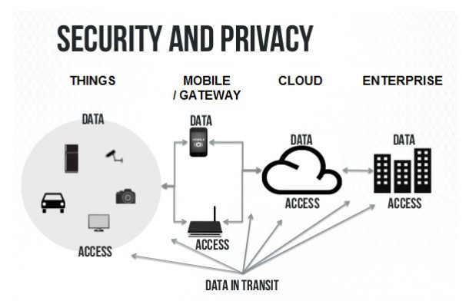
SECURITY & PRIVACY ISSUES

Slide 6
PROCESSES
Encryption-
In cryptography, encryption is the process of encoding the message or information in such a way that only authorized parties can access it and those who are not authorized cannot .
Cipher text – Encrypted Data
Decryption-
It is the process of decoding the encrypted data into an unencrypted data by an authorized user which requires a secret key or password.
Plain text – Unencrypted data

Slide 7
TERMINOLOGIES
01
Public Key
A cryptographic key that can be obtained and used by anyone to encrypt messages intended for a particular recipient.
02
Private key
The encrypted message can only be deciphered using a secret key known to the recipient called the private key.
03
Stream Cipher
It is a symmetric key cipher where plain text digits are combined with a pseudorandom cipher digit stream to give a digit of the cipher text stream
04
Block cipher
A Block cipher takes a block of plain text bits and generates a block of cipher text bits generally of same size

Slide 8
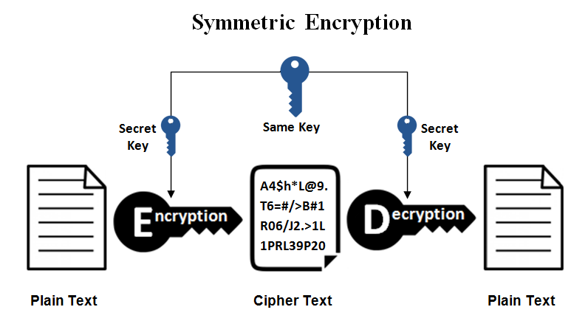
SYMMETRIC ENCRYPTION
It is the simplest kind of encryption that involves only one secret key which can be be a number, a word or a string of random letters to cipher and decipher information.
It is a blended with the plain text of a message to change the content in a particular way.
The sender and the recipient should know the secret key that is used to encrypt and decrypt all the messages.

Slide 9
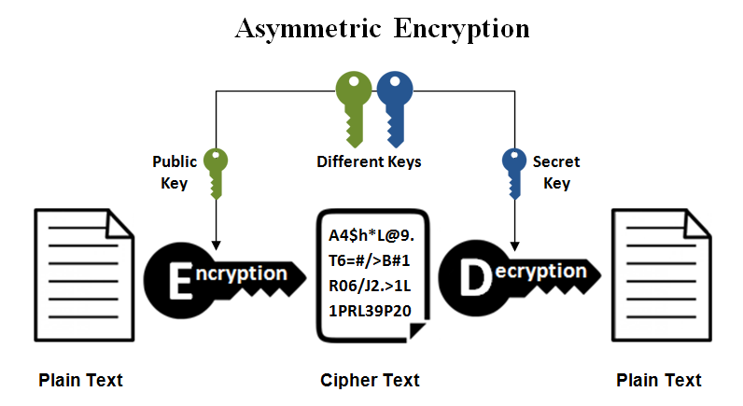
ASYMMETRIC ENCRYPTION
It uses two keys to encrypt a plain text.
Secret keys are exchanged over the Internet or a large network.
A public key is made freely available to anyone who might want to send a message.
The second private key is kept a secret so that receiver can only know.

Slide 10
WORK FLOW
Output Device
Decrypted Data (Plain Text)
20%
Decryption Algorithm
30%
Cloud Storage
Encrypted Data (Cipher Text)
50%
Encrypted Data (Cipher Text)
Encryption Algorithm
60%
Sensor
Data (Plain Text)

Slide 11
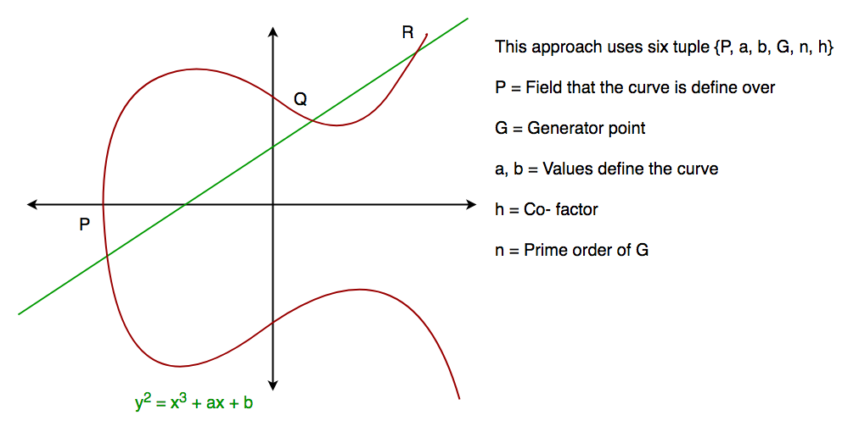
ELLIPTIC CURVE CRYPTOGRAPHY (ECC)

Slide 12




El GAMAL ENCRYPTION DECRYPTION ALGORITHM
1
2
Generation of public key and private key
6
Stop
5
Encryption using the public key
Decryption of encrypted message using private key
2
Generation of large numbers
4
Start

Slide 13
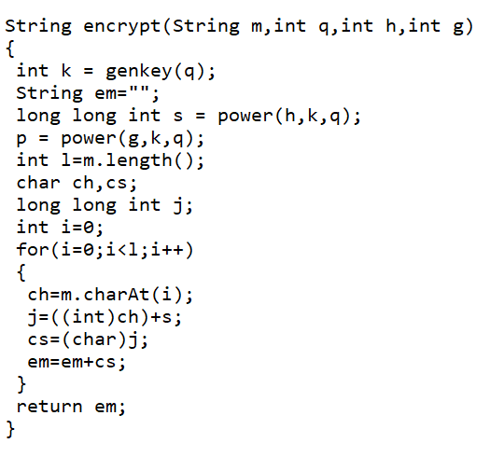
ENCRYPTION
Private key generation using genkey()
Generation of large numbers p and s
Performing mathematical operation
Returning encrypted string

Slide 14
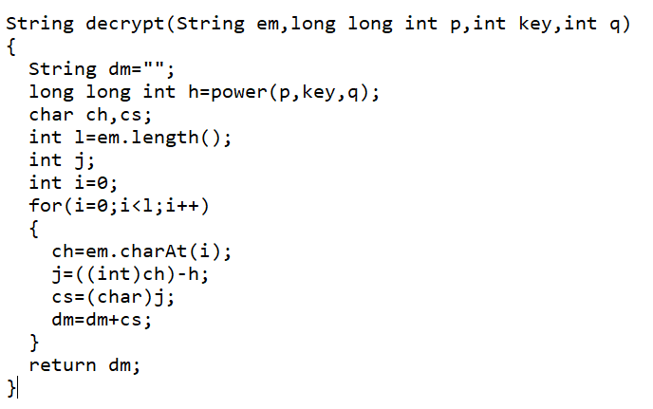
DECRYPTION
It receives encrypted message, private key and large number p and q
Generates h its own key
Performing mathematical operation
Returns the decrypted message

Slide 15
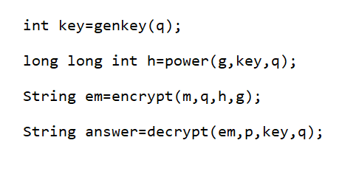
MAIN METHOD
Generation of key
Generation of large number h
Obtaining encrypted and decrypted message

Slide 16


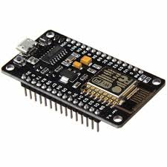


METHODOLOGY
Step 1:Connection of NodeMCU ESP8266 with laptop using USB cable.
Step2: Compilation of the code using Arduino IDE.

Slide 17




Step3: Uploading of the compiled code to NodeMCU ESP8266.
Step 4: Setting up of the web server using the IP address of mobile Wi-Fi.

Slide 18


Step 5: Loading of the data on web server
Step 5: Output view in web browser of the web server created by NodeMCU ESP8266.

Slide 19
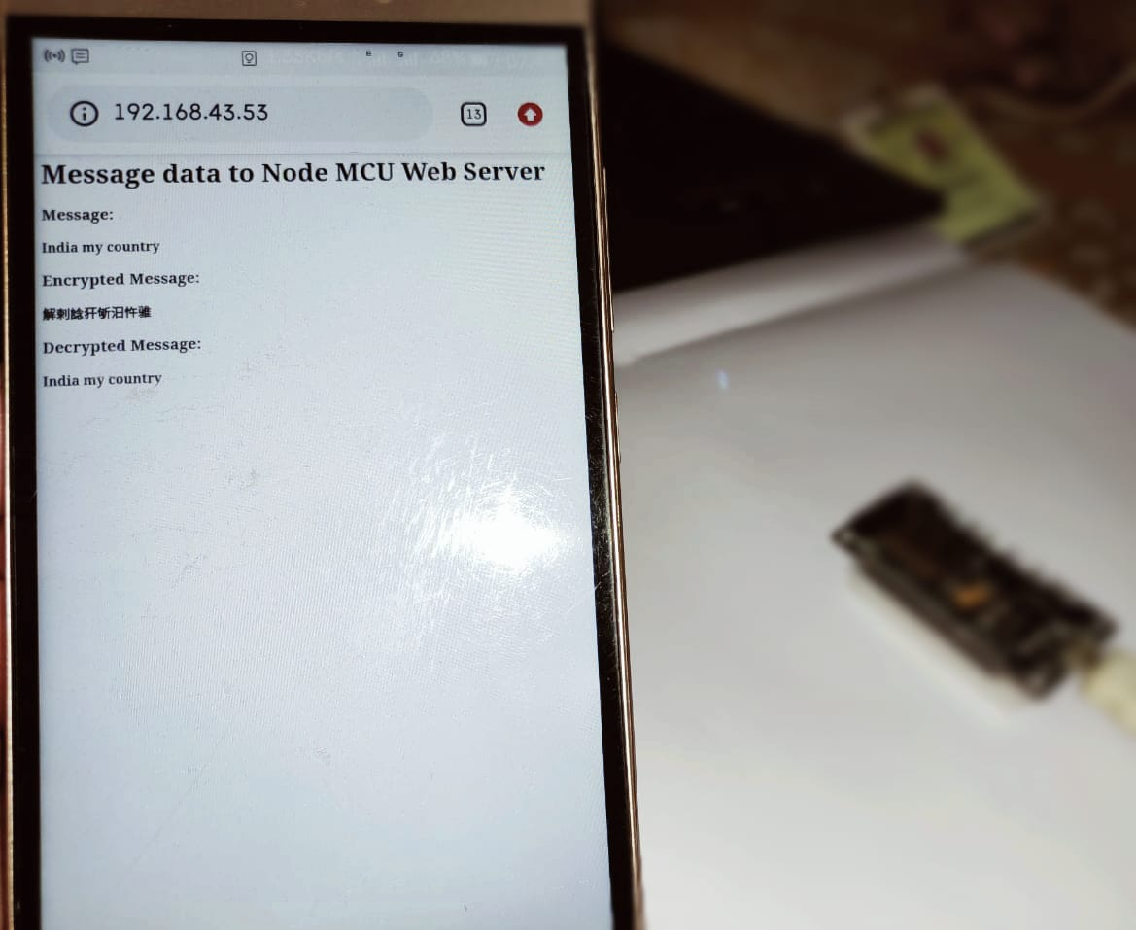
PRACTICAL SIMULATION

Slide 20
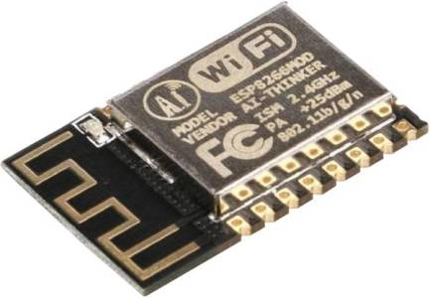
HARDWARE
NodeMCU is a low-cost open source IoT platform.It initially included firmware which run on the ESP8266 Wi-Fi SoC from Espressif Systems, and hardware which was based on the ESP-12 module.
It has a memory of 128KB storage of 4MB with an XTOS operating system.
Its operating voltage is 3.3V which is derived using USB.
The NodeMCU has a ESP8266 module which can operate as a station to connect it to the WiFi network.
It can also operate as a soft access point (soft-AP), to establish its own WiFi network.
The maximum number of stations connected to the soft-AP is five.

Slide 21

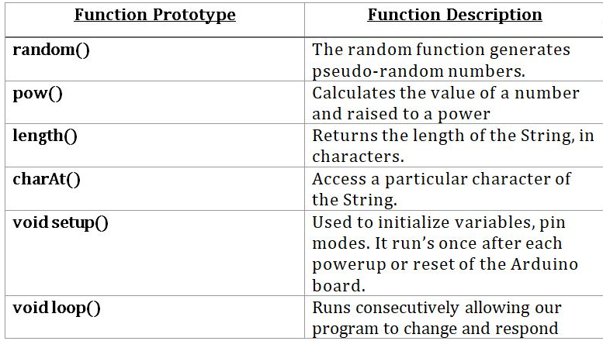
SOFTWARE
The Arduino Integrated Development Environment (IDE) is a cross-platform application (for Windows, macOS, Linux) that is written in functions from C and C++. It connects to the Arduino and Genuino hardware to upload programs and communicate with them.

Slide 22
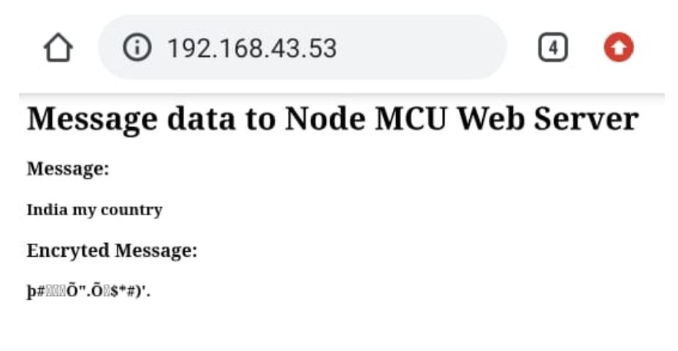
ENCRYPTION WITHOUT DECRYPTION

Slide 23
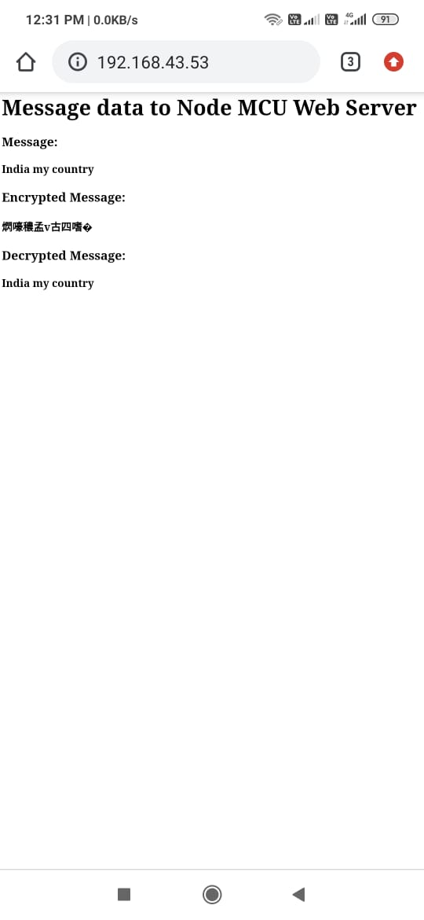
ENCRYPTION WITH DECRYPTION

Slide 24
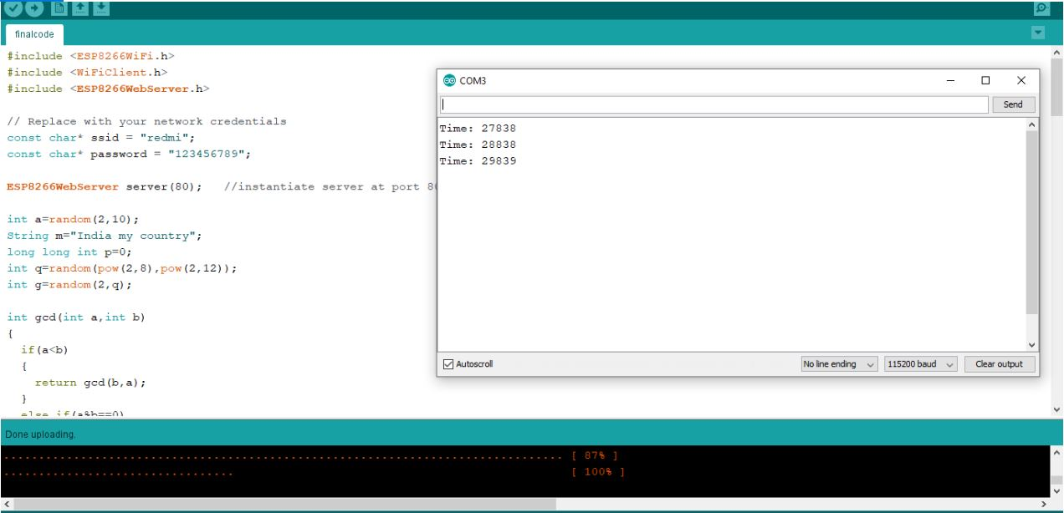
SERIAL MONITOR : EXECUTION TIME
Total time taken to execute the code as displayed in the serial monitor

Slide 25





PERFORMANCE ANALYSIS
Time required 21973 milliseconds to 45193 milliseconds
Space required is 3KB
Clock Speed of 80 MHZ
Power requirement is 3.3V

Slide 26
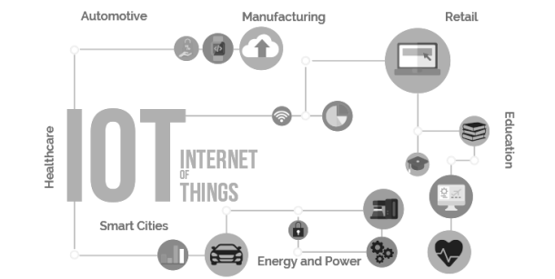
APPLICATION AREA
Wearable gadgets: Wearable devices such as smart watches and smart glasses.
Connected Car: Large-scale automobile companies to small-scale start-ups is working on connected car solutions.
Smart Home: Popular devices include smart thermostat, connected lights, smart fridge, smart door lock
Smart City: Smart city helps people to avoid the issues of traffic management, social security, waste management, water distribution etc

Slide 27
FUTURE SCOPE
The algorithm is designed in our project is light weight. In future the algorithm can be developed into ultra-light weight that can offer an advance level of security.
Our algorithm will be designed for specific type of attacks . In future the algorithm can automatically be updated depending on the level of the attacks.
3. The algorithm can be more optimized to work at a faster processing speed.

Slide 28
CONCLUSION
We believe that this project will reduce the threats in IoT data security to a large extent. To send and receive data at a faster pace is not only the primary concern but also protecting it is a duty while implanting newer technologies in IoT. In a nutshell, our project will serve as the basic step in achieving our goal to secure data and restrict its free access.

Slide 29
REFERENCE
[1] PRESENT: An Ultra-Lightweight Block Cipher
[2] Security in Internet of Things: Challenges, Solutions and Future Directions
[3] Security on Internet of Things (IOT) with Challenges and Countermeasures
[4] ARO_EDGE: A Technique to Ensure Data Security in Internet of Things (IoT)
[5] https://www.geeksforgeeks.org/elgamal-encryption-algorithm

Slide 30

THANK YOU

